Slide 1
LED and intelligent controls provides comfortable, energy efficient and sustainable lighting solutions Fagerhult Presentation at KONFERENCE ”ENERGY & WATER EFFICIENCY” by Patrik Malin / FAGERHULT

Slide 2
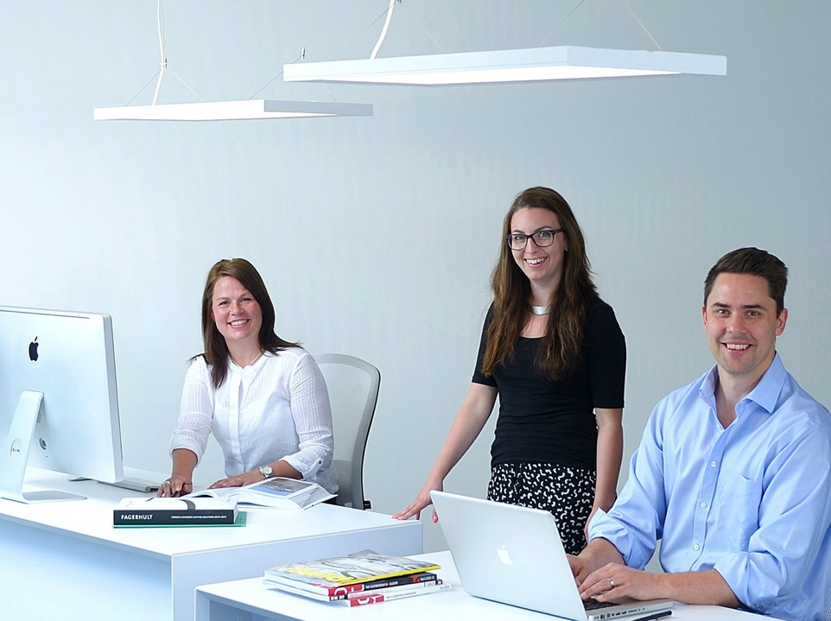

Slide 3
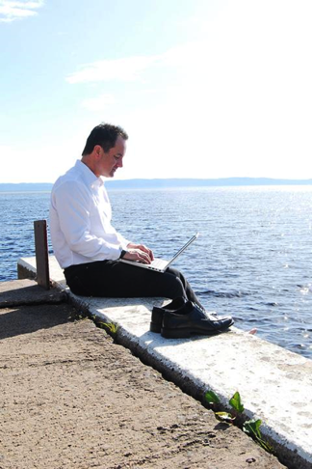
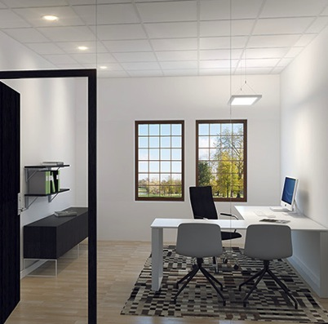
Office work is flexible today
Todays technique enables us to work anywhere.
The office becomes a place for meeting and inspiration.
The layout is based on how we work – the Activity Based Office (ABO) is here.
Notes:
Work is not what it used to be. Constantly connected, we don’t have to spend the entire working day at the office behind a desk. We work everywhere; at home, at the customer’s place or on the go.
Nevertheless, the office is more important than ever. It is here where we meet our colleagues, see how things are, and share our ideas and thoughts. Valuable energy and creativity are released during a social meeting.
Activity Based Office (ABO)
Now that technology no longer ties us to a specific place, the office is becoming activity based. It is the type of activity and tasks that govern where and how we work.
Companies are reducing office space and are offering their employees more flexible working. There are no fixed workplaces in the activity-based office. Everyone chooses the place that is suitable for the activity. Offices are planned on the basis of open spaces that are supplemented by partitioned rooms.
IWorkplaces becomes physically smaller, and fewer. When less employees spend the whole day in the office, it is possible to save on square meters and plan more effectively. Less surface provides cost savings for companies, but instead you put more resources into the interior.
t is generally considered that 70% of the employees can work without a dedicated desk, while 30% need a permanent workstation. These figures do, of course, vary considerably between different functions at the company. As, in order for ABO to work, extremely good technology and IT support is also required, this type of planning is more common in organisations with a strong focus on IT and communications.
Large offices and greater mobility among staff has led to an increased demand for smaller rooms where people can meet their colleagues in peace and quiet and to make plans. Having extra meeting rooms is a clear trend in new build offices, with the most common layout is for four to eight seats. Not that everyone is always physically present at the meeting of course. The need for meeting rooms is also driven by many people opting for video and phone conferencing rather than travelling.
Design at the workplace makes you more creative – and reinforces the company’s attractiveness and brand.
An exciting interior which matches the company’s identity has become ever more important when it comes to attracting new staff and reflecting the brand. Ergonomics and functionality are today viewed as natural parts of working life. An inspirational working environment has now become the new competitive edge.
But just putting out a few beanbags, a game console and a table tennis table simply isn’t enough.

Slide 4
Standard for workplace lighting EN 12464-1, - ambient light is also defined.
300 (50) lx
300 (75) lx
150 lx
150 lx
500 lx
500 lx
Notes:
Uusien ympäröivästä valosta saatujen tietojen perusteella standardia on uusittu, ja se sisältää nyt myös vaatimukset seinien ja kattojen minimivalaistusvoimakkuuksista.
Fagerhultin mielestä valon positiivisten vaikutusten täysimittainen hyödyntäminen edellyyttää standardista poiketen voimakkaampia valaistustasoja. Tämä tarkoittaa ympäröivän valon (epäsuoran valon) määrän lisäämistä katto- ja seinäpinnolle toimistoissa, kouluissa, terveydenhuollon tiloissa ja kohtaamisalueilla.
Työtasot: Standardi vaatii 500 lx
Tauluvalaistus: Standardi määrittää minimitasoksi 500 lx
Katot: Standardin alhaisimmaksi tasoksi määritellään koulutustiloissa vähintään 50 lx. Fagerhult suosittelee n. 300 lx.
Seinät: Standardin alhaisimmaksi tasoksi määritellään koulutustiloissa vähintään 75 lx. Fagerhult suosittelee n. 300 lx.
Sylinterivalaistus: Sylinterivalaistusvoimakkuus vaikuttaa visuaaliseen viestintään ja mahdollisuuteen tulkita kasvoja, tapahtumia ja kohteita. Standardi määrittää sen minimiarvoksi koulutustiloissa 150 lx.
Standardi edellyttää luokkahuoneisiin ja auditorioihin ohjattaa valaistusta sekä standardin EN 15193:2007 mukaisten energiamääräysten täyttymistä.

Slide 5
The Activity Based Office
The entrance
The open plan office
The cellular office
Activity area
Meeting rooms
Other rooms
The Activity Based Office challenge the lighting designer – for workplace and ambient light.
– what is a workplace and what is a coffe table in an Activity Based Office?
How to create enough ambient lighting in a room with no walls to light?
Notes:
The Activity Based Office challenge the lighting designer – for workplace and ambient light.
– what is a workplace and what is a coffe table in an Activity Based Office?
How to create enough ambient lighting in a room with no walls to light?

Slide 6
The office in new light Main messages/story
Innovative LED solutions for all areas ➔
➔ combined with smart lighting control 
➔ reduces energy use ➔
➔ that leads to a “green” building

Slide 7
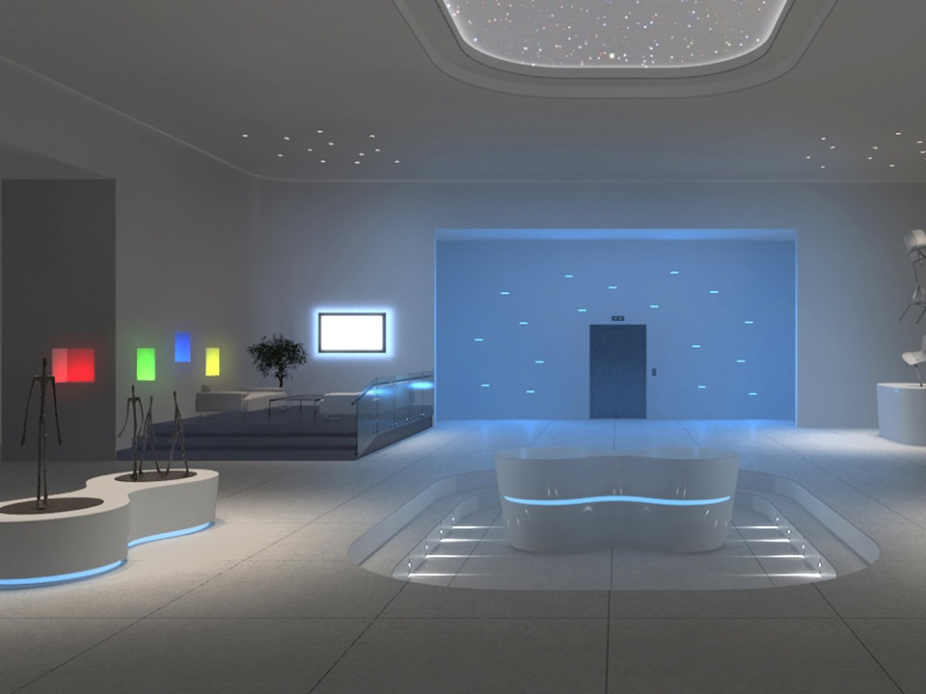
What is LED?
- Light Emitting Diode
LED is an electronic component, which transforms electric power into light
Notes:
LED är en förkortning av Light Emitting Diode, en ljusemitterande diod eller lysdiod.
En LED är en halvledare som avger ljus när den stimuleras elektriskt.
I en konventionell ljuskälla uppstår ljuset som en biprodukt vid uppvärmningen av en glödtråd eller vid en gasurladdning.
I en LED uppstår ljuset genom en elektrisk process där elektroner utjämnas mellan två områden i halvledaren.
Vid övergången uppstår ljus i gränsskiktet.
De olika halvledarmaterialen som förekommer är
Aluminium Gallium Arsenid, AlGaAs > röd LED
Aluminium Indium Gallium Fosfit, AlInGap > röd eller amber (lila) LED
Gallium Arsenid Fosfit, GaAsP > röd eller amber LED
Indium Gallium nitrit, InGaN > grön eller blå LED (oftast grunden för LED med vitt ljus)
---------------------------------
Click to see heading and first paragraph
Click get the rest of paragraphs one by one
Click to continue to next slide

Slide 8
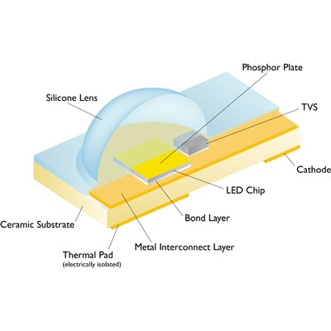
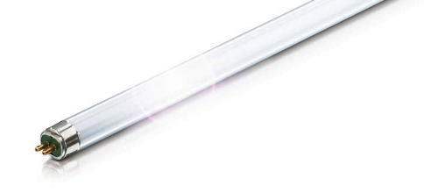
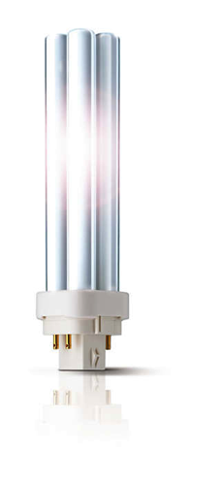
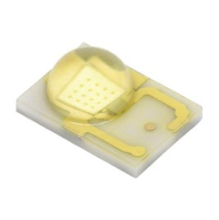
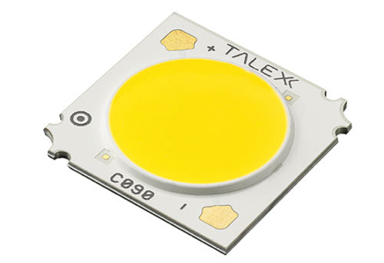

Slide 9
The new lighting for the new office
Combilume
Classic LED
Pleiad
Multilume
Indigo LED

Slide 10
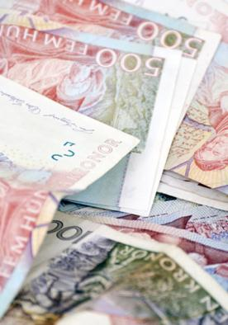
Why use lighting controls!!
Lighting control for economic reason
Energy efficient lighting saves money
Lighting control for sustainability
Environmental friendly
Lighting control for humans
Increased comfort and well-being

Slide 11
Light control in Individual offices
Energy saving ≤ 60 %
Manual on/off
IR-receiver
Daylight control
Absence control
Presence control
Dynamic light control – Tunable white

Slide 12
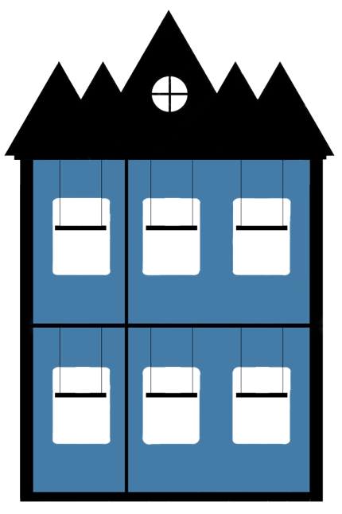
Functions for Lighting control
Manual control
Absence control
Presence control
Daylight control

Slide 13
Absence control
Lights are manually switched on …
When no movement is detected …
… the light goes off.

Slide 14
Presence control
Lights turn automatically on, when you enter the room…
When no movement is detected …
… the light goes off.

Slide 15
Daylight control
Lighting is on a constant level.
With increased daylight… … the electric lighting is automatically dimmed to a lower level.
With decreased daylight … … the electric lighting is adjusted to a higher level.

Slide 16
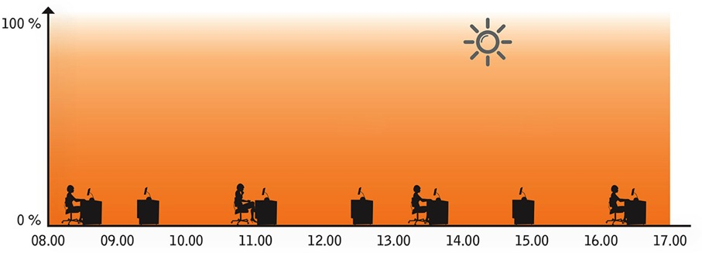
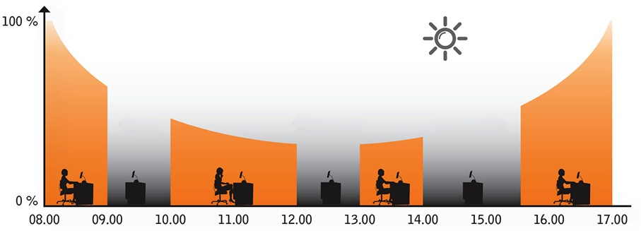
How to save energy with controls?
Enegy use: Daylight control combined with presence or absence control
Enegy use: Luminaires wthout controls
Customer visit
Lunch
Internal meeting
Source: Belysningsbranschen, Sweden

Slide 17
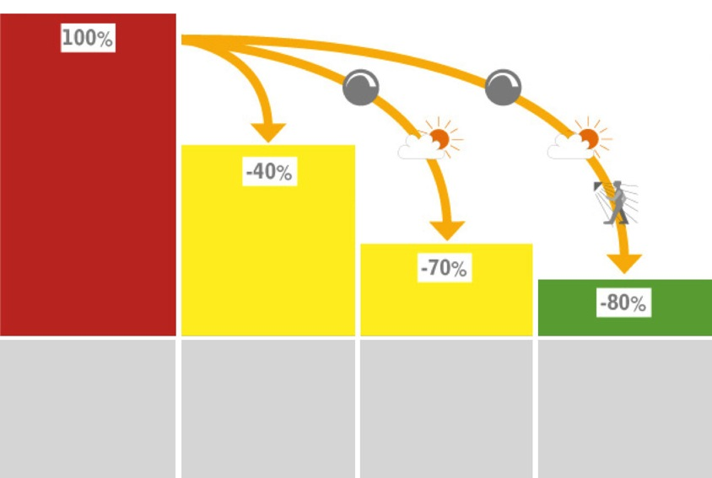
Energy efficient luminaires + controls = lower energy cost
T8 conventional
T5 fluorescent
T5 with control
LED with control
Source: Belysningsbranschen, Sweden

Slide 18
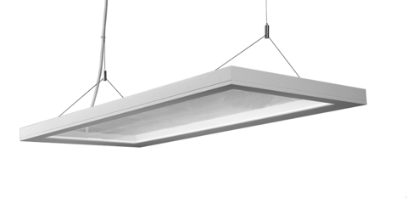
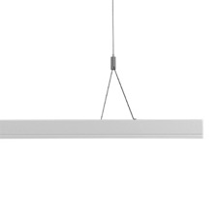
Combilume Direct/indirect
300x800 mm
4000 K
MacAdam 4 SDCM
50 W, 4739 lm, 105 lm/W
Side emitted light

Slide 19
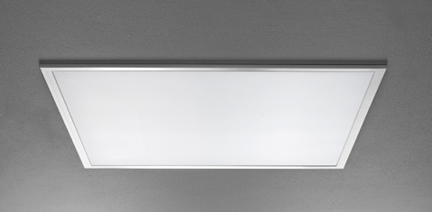
Multilume Flat
600x600 mm
3000/4000 K
MacAdam 3 SDCM
Delta
13–46 W, 1035–4650 lm, 90–110 lm/W
Apply to 3000 cd/m² for computer screens

Slide 20
Technology today – DALI Device Type 8
One driver controls both warm and cold diodes.
The desired colour temperatures are set directly in programming.
Notes:
DALI ballasts that are compatible with DALI Device Type 8 provide functionality for controlling colour temperature.
DALI ballasts that are compatible with DALI Device Type 8 are controlled with only one DALI address that controls both the cold and the hot diodes.
The function with different colour temperatures requires no programming with respect to the mixture of cold and warm light since the logic is built into the devices. The desired colour temperatures for different scenes are set directly in programming.

Slide 21
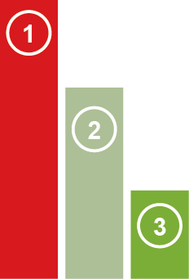
The entrance – a welcoming area for work and informal meetings
Luminary without controls
Luminary with controls
LED luminary with controls
Notes:
The first impression! A generous space with flexible environment furniture provides many usage options. Here visitors can take a seat and wait, employees can make informal handovers to colleagues, customers and suppliers, check e-mails or make phone calls. Maybe a catch up after work?
Suspended Tibi luminaires accentuate the architecture and the generous ceiling height. The luminaires are design objects which fulfil their function even when they are switched off.
Controls in the entrance – daylight and constant light
Graphic in all slides says (in all slides):
Conventional fittings without controls
Conventional fittings with controls
LED fittings with controls

Slide 22
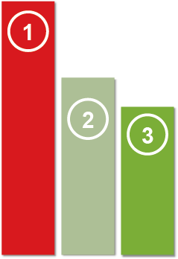
The open office – lighting for many demands
Notes:
At the end of the premises is an open office. A suspended Combilume with direct/indirect light above each workplace provides a good working light while at the same time the walls and ceiling receive comfortable ambient lighting. The size of the luminaires are adapted for the new, smaller desks. The walls receive extra Light thanks to Pleiad Wallwasher G3. The ambient lighting contributes to stimulating awareness and well-being and is one way to accentuate the spaciousness in the open-plan office.
Controls open plan office
– daylight, presence and constant

Slide 23
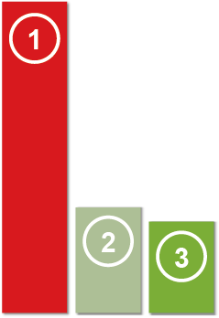
The cellular office – a room for focus and concentration
Notes:
The cell office is well lit for high visual comfort. A suspended Combilume with direct/indirect light provides a good working light on the desk and comfortable ambient lighting that is reflected from the ceiling and back wall. Pleiad Wallwasher G3 lights the opposite wall and creates a varied lighting environment which stimulates alertness and efficiency.
Controls cell – daylight, presence and constant

Slide 24
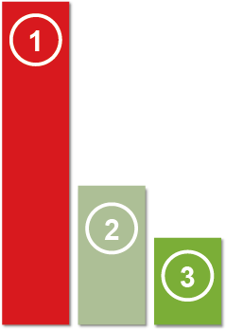
All areas can be used – not only for walking around
Notes:
The lighting can be used in order to clarify the various functions of the room and contribute to the structure in the open office. A more efficient use of communication areas – for example for storage, paper management or phone booths – places increased requirements on the lighting. Recessed Multilume Dropped provides an effective and comfortable light; some of the light reaches the ceiling which contributes to the sense of space. Pleiad G3 downlights along the ceiling edge create variation in the lighting environment.
Controls Communication area– daylight, presence and constant

Slide 25
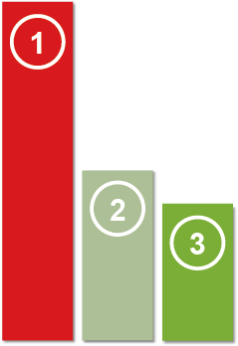
The small meeting room – a creative bubble
Notes:
At the end of the premises is a room for creativity. Lighting is needed here that can quickly be switched from atmospheric light to full working light. A Tibi hangs in a central position, providing a comfortable light on the walls and ceiling. The design of the luminaire makes it possible to play with the suspension without a risk of glare. In order to create an additional dynamic, we have lit the walls with Pleiad Wallwasher G3.
Controls litet möte– presence.

Slide 26
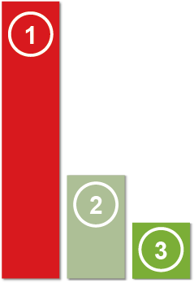
The small conference room – a place for smart meetings
Notes:
A smaller conference room that has been lit especially with video conferences and slideshows in mind. Recessed Indigo LED with its secondary reflector provides a good general light, reduces the risk of shadows and emphasises the faces of the meeting participants. Lighting planning with Indigo LED makes the interior fitting regardless of where the luminaire is located and the room can easily be refurnished without affecting the visual comfort.
Controls small conference room – daylight, presence and constant

Slide 27
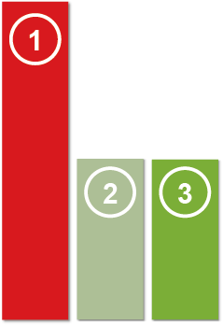
The large conference room – let’s do some business
Notes:
A large representative conference room for more official client meetings and board meetings. The large conference table’s central location is accentuated by two Freedom lines which twist around each other and follow the entire length of the table. Recessed Pleiad Evo along the walls contribute to increased spaciousness and visual comfort. The variation in the lighting helps the participants of the meeting to remain alert even during long meetings.
Controls large conference – absence

Slide 28
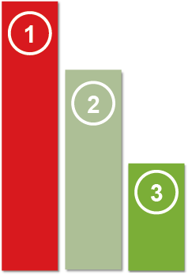
Open areas – room for work and meetings
Notes:
A large open office space that combines social functions with options for working individually or in a group. Two seating groups with high backs form small conference rooms that are accentuated by suspended luminaires in a cluster installation that amplifies the feeling of “rooms within a room”. The luminaire cluster can be dimmed from the seating groups according to the work activity. Tables are offered in various heights for standing or sitting tasks and for work, meetings or coffee breaks. Suspended Tibis provide excellent, glare-free working light while also lighting the ceiling. The lack of natural light deep inside the building is compensated by wall mounted Combilume luminaires that accentuate the feeling of daylight and keep concentration levels high. A creative position on the walls contributes to creating a dynamic and arousing interest. Further in the room several flexible workplaces are lit with a rectangle of suspended Notor LEDs. Along the edge of the mezzanine are downlights in order to amplify the direction in the room.
Controls open room – presence

Slide 29
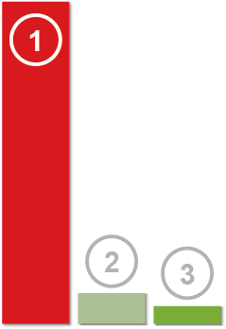
Parc with Allfive LED
Notes:
The garage is also part of the design of the office. The light has a function to create a sense of space and contributes to an increased feeling of safety. Using LED lighting and an adapted control it is possible to achieve a good light level while at the same time conserving energy. For example, the garage can be divided into different zones where the light is dimmed or turned off completely when nobody is there.
Here we show the first of two examples – which is a more traditional solution with AllFive.
Controls garage – presence

Slide 30
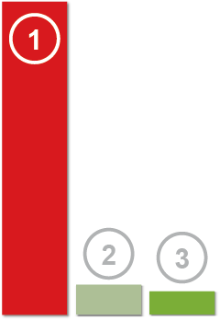
Well lit and fresh in restrooms
Notes:
Well lit hygienic areas contribute to a fresh space that is easy to maintain and pleasant to visit. Round beam Tibi ceiling also provides light on ceilings and walls and defines the room. Shine above the wash basin also lights the ceiling and wall and we can see ourselves in a clear and comfortable light without glare.
Controls in restrooms – presence

Slide 31
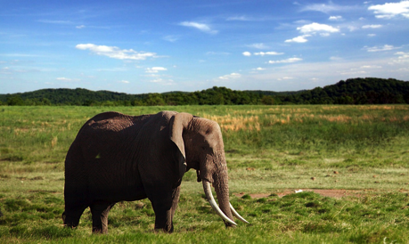
Light for activity and well-being
Natural light for humans
Tunable white in applikations

Slide 32
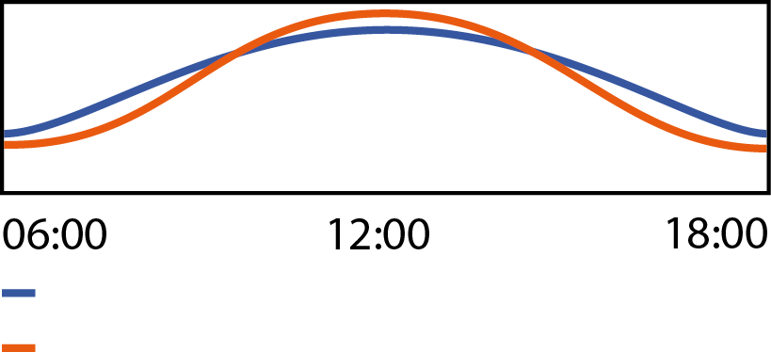
Tunable white – different situations require different light.
We are used to regulate the intensity of the light.
- Now we can also easily adjust the colour temperature!
Amount of light
Color temperature of light
Notes:
The height of our chairs, the size of the screen text and the volume on our phones,
we are increasing accustomed to being able to adjust and select our preferred settings in our working lives.
Its only really the lighting which we don’t adapt to our personal preference- and that’s about to change.
While it is often possible to set or change the intensity of the light, the colour temperature is dictated by someone else.
Wouldn’t it be fantastic to get a personal light?
Our preference for colour temperature isn’t static, sometimes we want a cold, activating light, others a warm relaxing one. In a hospital waiting room or a dentist surgery, for instance, a colder light level may not create the peaceful ambience we want.
Our preferences for light can also differ with age; the young are inclined towards a colder light while as we get older this changes to warm.
Tuneable White is a new technology which permits the user to alter the colour temperature to what we prefer within the same luminaire. In an open plan office it is hard to get a very personal lit experience but changing the colour temperature control can still enhance the ambience of the space. Other areas such as lobbies, receptions, conference room, cellular offices and waiting rooms are ideal environments for a tuneable white solution.

Slide 33
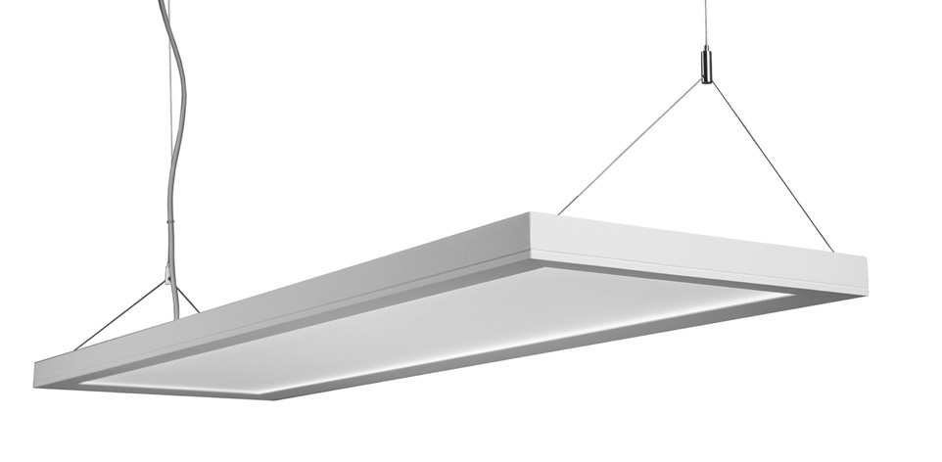
Advanced fully controllable office luminare
Amount of light
Color temperature of light
Notes:
Now the technology has reached the point when we can stimulate our inner clock with artificial light again, for activity and well-being during the day and the world can start turning again.

Slide 34
Personal light in the cellular office
Notes:
A cellular office is the easiest room to apply a Tuneable White solution as there is only one user who controls the light according to his or her preferences.
Think of a cold, intense light when you want to activate yourself or a warm dimmed light for conversations, reading and tasks which require concentration.
Using a suspended direct/indirect Combilume, supplemented with Pleiad Wallwasher G3, provides the ambient and task light requirements, with the colour temperature and intensity controlled via a simple panel on the wall.

Slide 35
Cellular office 2700 K
Notes:
A cellular office is the easiest room to apply a Tuneable White solution as there is only one user who controls the light according to his or her preferences.
Think of a cold, intense light when you want to activate yourself or a warm dimmed light for conversations, reading and tasks which require concentration.
Using a suspended direct/indirect Combilume, supplemented with Pleiad Wallwasher G3, provides the ambient and task light requirements, with the colour temperature and intensity controlled via a simple panel on the wall.

Slide 36
Cellular office 3000 K
Notes:
A cellular office is the easiest room to apply a Tuneable White solution as there is only one user who controls the light according to his or her preferences.
Think of a cold, intense light when you want to activate yourself or a warm dimmed light for conversations, reading and tasks which require concentration.
Using a suspended direct/indirect Combilume, supplemented with Pleiad Wallwasher G3, provides the ambient and task light requirements, with the colour temperature and intensity controlled via a simple panel on the wall.

Slide 37
Cellular office 4000 K
Notes:
A cellular office is the easiest room to apply a Tuneable White solution as there is only one user who controls the light according to his or her preferences.
Think of a cold, intense light when you want to activate yourself or a warm dimmed light for conversations, reading and tasks which require concentration.
Using a suspended direct/indirect Combilume, supplemented with Pleiad Wallwasher G3, provides the ambient and task light requirements, with the colour temperature and intensity controlled via a simple panel on the wall.

Slide 38
Cellular office 5000 K
Notes:
A cellular office is the easiest room to apply a Tuneable White solution as there is only one user who controls the light according to his or her preferences.
Think of a cold, intense light when you want to activate yourself or a warm dimmed light for conversations, reading and tasks which require concentration.
Using a suspended direct/indirect Combilume, supplemented with Pleiad Wallwasher G3, provides the ambient and task light requirements, with the colour temperature and intensity controlled via a simple panel on the wall.

Slide 39
Cellular office 6500 K
Notes:
A cellular office is the easiest room to apply a Tuneable White solution as there is only one user who controls the light according to his or her preferences.
Think of a cold, intense light when you want to activate yourself or a warm dimmed light for conversations, reading and tasks which require concentration.
Using a suspended direct/indirect Combilume, supplemented with Pleiad Wallwasher G3, provides the ambient and task light requirements, with the colour temperature and intensity controlled via a simple panel on the wall.

Slide 40
Dynamic in the open plan office
Notes:
Open plan offices cannot be controlled to reflect each individual's personal preferences since the room is lit for a group of people.
Here we recommend a router solution that varies the light over time and adjusts the colour temperature mimicking the light outdoors.
In the ceiling we have Multilume Flat and, to strengthen the sense of a natural daylight, the walls are lit using Pleiad Wallwasher G3.

Slide 41
Open plan office 2700 K
Notes:
Open plan offices cannot be controlled to reflect each individual's personal preferences since the room is lit for a group of people.
Here we recommend a router solution that varies the light over time and adjusts the colour temperature mimicking the light outdoors.
In the ceiling we have Multilume Flat and, to strengthen the sense of a natural daylight, the walls are lit using Pleiad Wallwasher G3.

Slide 42
Open plan office 3000 K
Notes:
Open plan offices cannot be controlled to reflect each individual's personal preferences since the room is lit for a group of people.
Here we recommend a router solution that varies the light over time and adjusts the colour temperature mimicking the light outdoors.
In the ceiling we have Multilume Flat and, to strengthen the sense of a natural daylight, the walls are lit using Pleiad Wallwasher G3.

Slide 43
Open plan office 4000 K
Notes:
Open plan offices cannot be controlled to reflect each individual's personal preferences since the room is lit for a group of people.
Here we recommend a router solution that varies the light over time and adjusts the colour temperature mimicking the light outdoors.
In the ceiling we have Multilume Flat and, to strengthen the sense of a natural daylight, the walls are lit using Pleiad Wallwasher G3.

Slide 44
Open plan office 5000 K
Notes:
Open plan offices cannot be controlled to reflect each individual's personal preferences since the room is lit for a group of people.
Here we recommend a router solution that varies the light over time and adjusts the colour temperature mimicking the light outdoors.
In the ceiling we have Multilume Flat and, to strengthen the sense of a natural daylight, the walls are lit using Pleiad Wallwasher G3.

Slide 45
Open plan office 6500 K
Notes:
Open plan offices cannot be controlled to reflect each individual's personal preferences since the room is lit for a group of people.
Here we recommend a router solution that varies the light over time and adjusts the colour temperature mimicking the light outdoors.
In the ceiling we have Multilume Flat and, to strengthen the sense of a natural daylight, the walls are lit using Pleiad Wallwasher G3.

Slide 46
University research about ambient lighting and health
Do pupils feel and perform better in indirect LED?
Does ambient light affect learning?
2013
Direct or direct/indirect light?
2011
2009
2007
2001
!
2002
Vertical light –
LED or T5?
Vertical light – do lighting levels and colour temperatures matter?
The third receptor!
Notes:
The first study, together with Jönköping University found that people preferred light in the ceiling and on walls, the ambient light.
2002 came the discovery of the third receptor in the retina which explained how people perceive light!
The second study, together with Lund University, was conducted in Åhus and studied how different levels of ambient light affects us and our hormone production. The study showed that it is the level which is the key and not the colour temperature.
The third study was conducted in collaboration with with Lund University and University College London. The study took place at a middle school in London 2009-2010.
We measured hormone levels, academic performance and well-being of pupils in classrooms with different lighting applications . The study showed that students felt better, were more alert and learned more if they had higher levels of ambient light.
The fourth study, together with Lund University was conducted in Åhus and studied how we perceive the difference in ambient light from LED and fluorescent light. The study showed that we perceive light from LED as brighter than the light from fluorescent lamps, although the lux meter shows the same value.
The fifth study and the one we shall talk about today was conducted at a high school in Helsingborg during the academic year 2012-2013. Here we compared a classic T5 solution with a new innovative LED solution with indirect light . The study is officially called: ENERGY EFFICIENT AND STUDY PROMOTING LIGHTING AT SCHOOL.

Slide 47
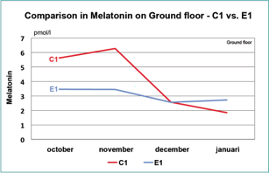
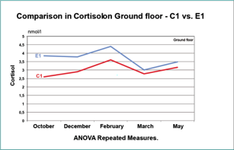
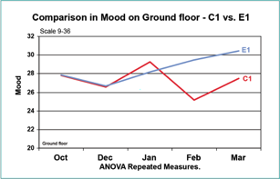
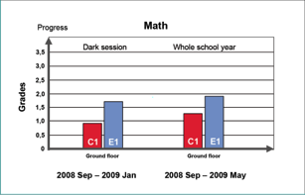
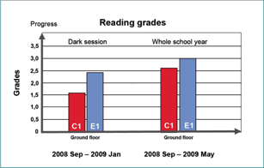
Ambient light affects learning in schools and can improve grades
Pupils more alert during dark period
Pupils more active in general
Pupils reached better grades
Notes:
Tutkimus osoitti, että testiluokassa, jossa oli enemmän ympäröivää valoa, oppilaat olivat aamuisin vireämpiä, voivat paremmin ja saavuttivat parempia tuloksia matematiikassa, lukemisessa ja kirjoittamisessa – varsinkin vuoden pimeimpinä aikoina.
Parempi ympäröivän valon määrä vaikutti positiivisesti oppilaisiin neljällä eri tavalla:
1. Oppilaat olivat merkittävästi pirteämpiä aamuisin (klo 09.50) – heidän melatoniinitasot (unihormoni) olivat matalammalla tasolla vuoden pimeimpinä aikoina lokakuusta tammikuuhun.
2. Oppilaat olivat merkittävästi aktiivisempia aamuisin (klo 09.50) – heidän kortisolitasot (stressihormoni) olivat korkeammalla tasolla koko kouluvuoden ajan.
3. Oppilaat näyttivät voivan paremmin koko kouluvuoden ajan.
4. Oppilaat saavuttivat parempia oppimistuloksia matematiikassa, lukemisessa ja kirjoittamisessa koko kouluvuoden ajan ja erityisesti vuoden pimeimpinä aikoina lokakuusta tammikuuhun.

Slide 48
Crystal Clear – sustainable thinking
Highly efficient lighting solutions with intelligent controls and LED makes small carbon footprint.
Product design to facilitate recycling.
Choice of non-hazardous material and components.
“Clean and lean” manufacturing e.g. use of hydroelectric power.
Notes:
Crystal Clear is Fagerhult's environmental initiative. It's our way of emphasising the importance of working in a way that leaves behind the least possible environmental impact. And in doing so, it is also important that we focus on people. The people for whom we make lighting, but also our employees, and above all the coming generations.
Its not only about the impact from our products but also how we manufacture them.
“Clean and lean” manufacturing where we strive to make is as environmental friendly as possible by looking at all the options e.g. use of hydroelectric power where we can.
We carefully choose materials and components, both in order to minimise impact but also design to support recycling.
Whenever possible we use materials with the lowest content of hazardous material ex. - HG in fluorescent lamps - PVC free cables
We are a member of national re-cycling initiatives in the industry.
Contribute to good social development through lighting solutions which increase people’s well-being
Create positive working conditions for our employees, regardless of country
Develop Fagerhult as an attractive employer

Slide 49
Our initiatives
Environmental classification
LEED
BREEAM
Green Building Council
Notes:
Environmental classification systems
Many international organisations are working in a variety of ways to improve how businesses work long-term with environmental issues. Some of the biggest of these are presented in brief below.
LEED
LEED stands for Leadership in Energy and Environmental Design. It's a system to promote resource-efficient and environmentally sustainable design and construction. The system is voluntary and comes from the USA, where it was developed by the U.S. Green Building Council (USGBC).
Read more about LEED...
BREEM
BRE Environmental Assessment Method (BREEAM) is an environmental classification system from the UK developed and managed by BRE, which was formerly a state institution but which is now owned by a consortium of industry players. BREEAM is one of the oldest environmental classification systems and has been used to certify just on 115,000 buildings, most of which are located in the UK. The system has existed in various revised versions since 1990, and is the most widespread of the international systems found in Europe.
BREEAM has developed a number of assessment tools and guides for different types of buildings. These can be used for both existing buildings and in project planning for new buildings. The environmental performance of buildings is assessed within a number of different areas. There are minimum requirements for achieving points in terms of project management, the building's energy use, the internal environment such as ventilation and lighting, water use, waste management and land use and impact on the immediate environment. Read more about BREEM...
World Green Building Council
The World Green Building Council (World GBC) is an umbrella organisation, the purpose of which is to assist national Green Building Councils in their start-up and development phases. The World Green Building Council represents the entire global construction sector. Together, its member countries comprise 50% of total construction activities in the world, and their national councils affect more than 10,000 businesses and industry organisations.
Läs mer om World Green Building Council...

Slide 50
The office in new light Main messages/story
Innovative LED solutions for all areas ➔
➔ combined with smart lighting control 
➔ reduces energy use ➔
➔ that leads to a “green” building

Slide 51
Intelligent control – sustainable LED-solutions

Slide 52
Fagerhult Group
Net sales € 450 m
2 700 employees worldwide
Sales companies in 17 countries
Production in Europe, Asia and the Pacific
Notes:
The Fagerhult Group is one of the top four players in the European lighting industry.
Outside these 17 countries we have sales representatives in a number of additional countries.

